Slide 1


CMR TECHNICAL CAMPUS
UGC(Autonomous)
Kandlakoya , Medchal Road,Hyd-501 401 Department of Computer Science & Engineering
Major Project On
Trustworthy and Reliable Deep Learning Based Cyberattack Detection in Industrial IOT
BATCH NO : 22
Project Guide: BATCH MEMBERS:
CH. REKHA 217R1A05A1 K. ANIL KUMAR
Assistant Professor, CSE Department 217R1A05C0 S. RAHUL
217R5A0596 K.TEJESHWAR
Project Coordinator:
Dr. J. Narasimharao
Associate Professor, CSE Department

Slide 2
CONTENTS
Abstract
Existing System
Disadvantages of Existing System
Proposed System
Advantages of Proposed System
System Requirements
Novelty Of Project
System Architecture
Modules
UML Diagrams
Conclusion

Slide 3
ABSTRACT
A fundamental expectation of the stakeholders from the Industrial Internet of Things (IIoT) is its trustworthiness and sustainability to avoid the loss of human lives in performing a critical task.
A trustworthy IIoT-enabled network encompasses fundamental security characteristics, such as trust, privacy, security, reliability, resilience, and safety. The traditional security mechanisms and procedures are insufficient to protect these networks owing to protocol differences, limited update options, and older adaptations of the security mechanisms.
As a result, these networks require novel approaches to increase trust level and enhance security and privacy mechanism.Therefore, in this article, we propose a novel approach to improve the trustworthiness of IIoT-enabled networks. The proposed scheme combines the deep learning- based pyramidal recurrent units (PRU) and decision tree (DT) with SCADA-based IIoT networks.

Slide 4
EXISTING SYSTEM
The Internet of Things (IoT) has revolutionized modern tech with interconnected smart devices. While these innovations offer unprecedented opportunities, they also introduce complex security challenges.
Cybersecurity is a pivotal concern for intrusion detection systems (IDS). Deep Learning has shown promise in effectively detecting and preventing cyberattacks on IoT devices.
Although IDS is vital for safeguarding sensitive information by identifying and mitigating suspicious activities, conventional IDS solutions grapple with challenges in the IoT context.
This paper delves into the cutting-edge intrusion detection methods for IoT security, anchored in Deep Learning. We review recent advancements in IDS for IoT, highlighting the underlying deep learning algorithms, associated datasets, types of attacks, and evaluation metrics. Further, we discuss the challenges faced in deploying Deep Learning for IoT security and suggest potential areas for future research

Slide 5
DISADVANTAGES OF EXISTING SYSTEM
The complexity of data: Most of the existing machine learning models must be able to accurately interpret large and complex datasets to detect Cyber Attacks.
Data availability: Most machine learning models require large amounts of data to create accurate predictions. If data is unavailable in sufficient quantities, then model accuracy may suffer.
Incorrect labeling: The existing machine learning models are only as accurate as the data trained using the input dataset. If the data has been incorrectly labeled, the model cannot make accurate predictions.

Slide 6
PROPOSED SYSTEM
By considering the limitations of previous techniques, we employ network attributes of industrial protocols and propose a pyramidal recurrent unit (PRUs)- and decision tree (DT)-based ensemble detection mechanism
The proposed mechanism has the potential to detect cyberattacks in any extensive industrial network. The interoperability with other detection engines and expandability for a wider industrial network with multiple areas distinguishes the proposed mechanism from previous studies.
The proposed detection method is disseminable across many IIoT domains. Furthermore, our model is straightforward to implement and deploy and can improve efficiency and accuracy while overcoming the shortcomings of previous efforts.

Slide 7
ADVANTAGES OF PROPOSED SYSTEM
We propose a scalable and efficient DL- and DT-based ensemble cyber-attack detection framework to resolve trustworthiness issues in the SCADA-based IIoT networks.
We present an efficient probing approach by the SCADAbased network data to solve the protocol mismatch limitations of traditional security solutions for the IIoT platform.
A statistical analytic approach for ensuring the trustworthiness and reliability of the proposed model for SCADA based IIoT networks.These models can often be integrated with existing security infrastructure, enhancing the overall cybersecurity posture without requiring a complete overhaul.
Many industries are subject to regulations that require robust cybersecurity measures. Implementing deep learning-based detection can help organizations meet these compliance requirements more effectively.

Slide 8
SYSTEM REQUIRMENTS
HARDWARE REQUIRMENTS
Processor - Pentium –IV
RAM - 4 GB (min)
Hard Disk - 20 GB
Key Board - Standard Windows Keyboard
Mouse - Two or Three Button Mouse
Monitor - SVGA

Slide 9
SOFTWARE REQUIRMENTS
Operating system : Windows 7 Ultimate
Coding Language : Python
Front End : Python
Back End : Django - ORM
Designing : HTML, CSS, Javascript
Data Base : MySQL(WAMP Server)

Slide 10
NOVELTY OF PROJECT
This project explores the application of advanced deep learning techniques to enhance cyberattack detection in Industrial IoT (IIoT) environments. The novelty lies in the integration of state-of-the-art algorithms with unique data preprocessing methods tailored specifically for IIoT devices.
By leveraging diverse datasets that encompass various industrial scenarios and attack vectors, the project aims to develop a model that not only detects known threats but also adapts to new, evolving cyber risks.
Additionally, the incorporation of explainable AI (XAI) techniques ensures that detection results are interpretable, fostering trust among users and facilitating timely decision-making.
This combination of advanced detection capabilities and user transparency positions the project as a significant contribution to the field of cybersecurity in IIoT.

Slide 11
SYSTEM ARCHITECTURE
Datasets Results Storage
Service Provider
Login,
Train & Test Datasets,
View Trained and Tested Datasets Accuracy in Bar Chart,
View Trained and Tested Accuracy Results,
View Prediction Of Cyber Attack Type,
View Cyber Attack Type Ratio,
Download Predicted Data Sets,
View Cyber Attack Type Ratio Results,
View All Remote Users.
Web Server
Accepting all Information
Accessing Data
Process all user queries
WEB Database
Remote User
REGISTER AND LOGIN,
PREDICT CYBER ATTACK TYPE,
VIEW YOUR PROFILE.

Slide 12
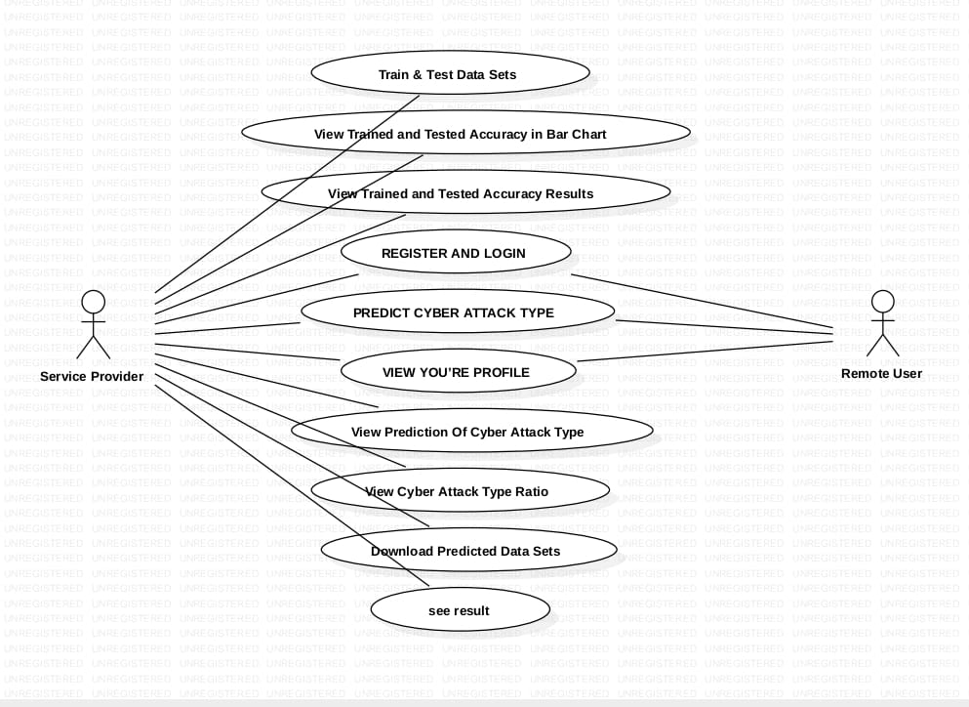
UML DIAGRAMS
USE CASE DIAGRAM

Slide 13
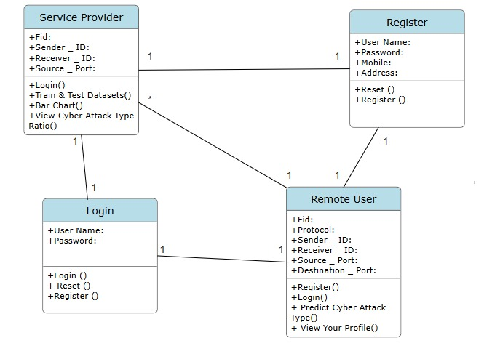
CLASS DIAGRAM

Slide 14
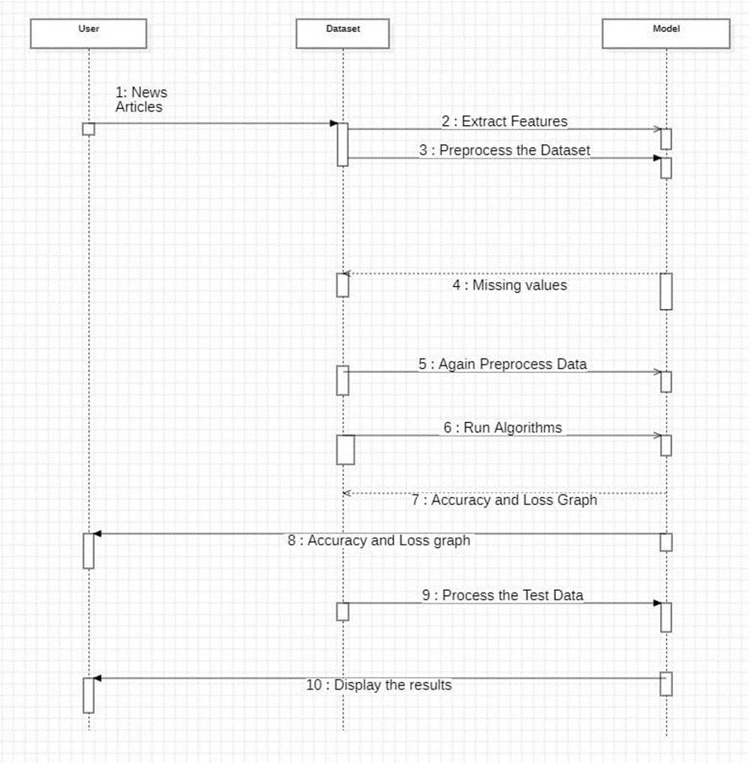
SEQUENCE DIAGRAM

Slide 15
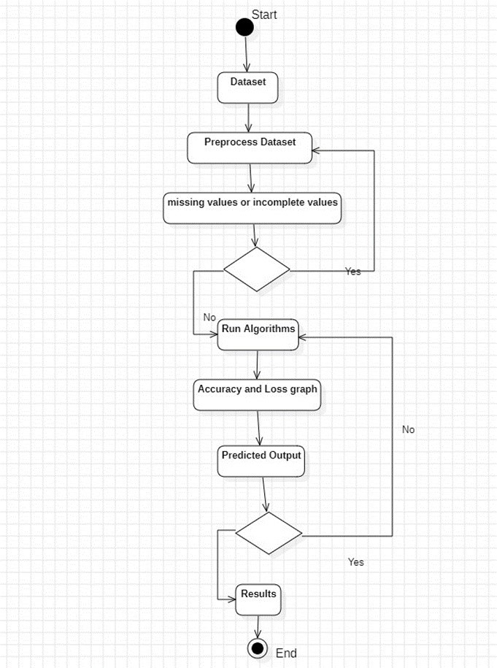
ACTIVITY DIAGRAM

Slide 16
SAMPLE CODE
REMOTE USER
from django.db.models import Count
from django.db.models import Q
from django.shortcuts import render, redirect, get_object_or_404
import datetime
import openpyxl
import pandas as pd
from sklearn.feature_extraction.text import CountVectorizer
from sklearn.metrics import accuracy_score, confusion_matrix, classification_report
from sklearn.metrics import accuracy_score
from sklearn.tree import DecisionTreeClassifier
from sklearn.ensemble import VotingClassifier
# Create your views here.
from Remote_User.models import ClientRegister_Model,cyberattack_detection,detection_ratio,detection_accuracy
def login(request):
if request.method == "POST" and 'submit1' in request.POST:
username = request.POST.get('username')
password = request.POST.get('password')
try:
enter = ClientRegister_Model.objects.get(username=username,password=password)
request.session["userid"] = enter.id
return redirect('ViewYourProfile')
except:
pass
return render(request,'RUser/login.html')

Slide 17
def Add_DataSet_Details(request):
return render(request, 'RUser/Add_DataSet_Details.html', {"excel_data": ''})
def Register1(request):
if request.method == "POST":
username = request.POST.get('username')
email = request.POST.get('email')
password = request.POST.get('password')
phoneno = request.POST.get('phoneno')
country = request.POST.get('country')
state = request.POST.get('state')
city = request.POST.get('city')
ClientRegister_Model.objects.create(username=username, email=email, password=password, phoneno=phoneno,
country=country, state=state, city=city)
return render(request, 'RUser/Register1.html')
else:
return render(request,'RUser/Register1.html')
def ViewYourProfile(request):
userid = request.session['userid']
obj = ClientRegister_Model.objects.get(id= userid)
return render(request,'RUser/ViewYourProfile.html',{'object':obj})
def Predict_Cyber_Attack_Type(request):
if request.method == "POST":
if request.method == "POST":
Fid= request.POST.get('Fid')
Protocol= request.POST.get('Protocol')
Flag= request.POST.get('Flag')

Slide 18
Packet= request.POST.get('Packet')
Sender_ID= request.POST.get('Sender_ID')
Receiver_ID= request.POST.get('Receiver_ID')
Source_IP_Address= request.POST.get('Source_IP_Address')
Destination_IP_Address= request.POST.get('Destination_IP_Address')
Source_Port= request.POST.get('Source_Port')
Destination_Port= request.POST.get('Destination_Port')
Packet_Size= request.POST.get('Packet_Size')
dataset = pd.read_csv("Datasets.csv", encoding='latin-1')
def apply_results(label):
if (label == 0):
return 0 # Cross Site Scripting
elif (label == 1):
return 1 # DoS
elif (label == 2):
return 2 # Password Attacks
dataset['Results'] = dataset['Label'].apply(apply_results)
cv = CountVectorizer()
x = dataset['Fid'].apply(str)
y = dataset['Results']
cv = CountVectorizer()
print(x)
print("Y")
print(y)
x = cv.fit_transform(x)
models = []

Slide 19
from sklearn.model_selection import train_test_split
X_train, X_test, y_train, y_test = train_test_split(x, y, test_size=0.20)
X_train.shape, X_test.shape, y_train.shape
print("Deep Neural Network-DNN")
from sklearn.neural_network import MLPClassifier
mlpc = MLPClassifier().fit(X_train, y_train)
y_pred = mlpc.predict(X_test)
testscore_mlpc = accuracy_score(y_test, y_pred)
accuracy_score(y_test, y_pred)
print(accuracy_score(y_test, y_pred))
print(accuracy_score(y_test, y_pred) * 100)
print("CLASSIFICATION REPORT")
print(classification_report(y_test, y_pred))
print("CONFUSION MATRIX")
print(confusion_matrix(y_test, y_pred))
models.append(('MLPClassifier', mlpc))
# SVM Model
print("SVM")
from sklearn import svm
lin_clf = svm.LinearSVC()
lin_clf.fit(X_train, y_train)
predict_svm = lin_clf.predict(X_test)
svm_acc = accuracy_score(y_test, predict_svm) * 100
print(svm_acc)
print("CLASSIFICATION REPORT")
print(classification_report(y_test, predict_svm))
print("CONFUSION MATRIX")
print(confusion_matrix(y_test, predict_svm))
models.append(('svm', lin_clf))
print("Logistic Regression")

Slide 20
from sklearn.linear_model import LogisticRegression
reg = LogisticRegression(random_state=0, solver='lbfgs').fit(X_train, y_train)
y_pred = reg.predict(X_test)
print("ACCURACY")
print(accuracy_score(y_test, y_pred) * 100)
print("CLASSIFICATION REPORT")
print(classification_report(y_test, y_pred))
print("CONFUSION MATRIX")
print(confusion_matrix(y_test, y_pred))
models.append(('logistic', reg))
print("Decision Tree Classifier")
dtc = DecisionTreeClassifier()
dtc.fit(X_train, y_train)
dtcpredict = dtc.predict(X_test)
print("ACCURACY")
print(accuracy_score(y_test, dtcpredict) * 100)
print("CLASSIFICATION REPORT")
print(classification_report(y_test, dtcpredict))
print("CONFUSION MATRIX")
print(confusion_matrix(y_test, dtcpredict))
models.append(('DecisionTreeClassifier', dtc))
classifier = VotingClassifier(models)
classifier.fit(X_train, y_train)
y_pred = classifier.predict(X_test)
Fid1 = [Fid]
vector1 = cv.transform(Fid1).toarray()
predict_text = classifier.predict(vector1)
pred = str(predict_text).replace("[", "")
pred1 = pred.replace("]", "")
prediction = int(pred1)

Slide 21
if prediction == 0:
val = 'Cross Site Scripting'
elif prediction == 1:
val = 'DoS'
elif prediction == 2:
val = 'Password Attacks'
print(val)
print(pred1)
cyberattack_detection.objects.create(
Fid=Fid,
Protocol=Protocol,
Flag=Flag,
Packet=Packet,
Sender_ID=Sender_ID,
Receiver_ID=Receiver_ID,
Source_IP_Address=Source_IP_Address,
Destination_IP_Address=Destination_IP_Address,
Source_Port=Source_Port,
Destination_Port=Destination_Port,
Packet_Size=Packet_Size,
Prediction=val)
return render(request, 'RUser/Predict_Cyber_Attack_Type.html',{'objs': val})
return render(request, 'RUser/Predict_Cyber_Attack_Type.html')

Slide 22
SERVICE PROVIDER
from django.db.models import Count, Avg
from django.shortcuts import render, redirect
from django.db.models import Count
from django.db.models import Q
import datetime
import xlwt
from django.http import HttpResponse
import numpy as np
import pandas as pd
from sklearn.feature_extraction.text import CountVectorizer
from sklearn.metrics import accuracy_score, confusion_matrix, classification_report
from sklearn.metrics import accuracy_score
from sklearn.tree import DecisionTreeClassifier
# Create your views here.
from Remote_User.models import ClientRegister_Model,cyberattack_detection,detection_ratio,detection_accuracy
def serviceproviderlogin(request):
if request.method == "POST":
admin = request.POST.get('username')
password = request.POST.get('password')
if admin == "Admin" and password =="Admin":
detection_accuracy.objects.all().delete()
return redirect('View_Remote_Users')
return render(request,'SProvider/serviceproviderlogin.html')

Slide 23
def View_Cyber_Attack_Type_Ratio(request):
detection_ratio.objects.all().delete()
rratio = ""
kword = 'Cross Site Scripting'
print(kword)
obj = cyberattack_detection.objects.all().filter(Q(Prediction=kword))
obj1 = cyberattack_detection.objects.all()
count = obj.count();
count1 = obj1.count();
ratio = (count / count1) * 100
if ratio != 0:
detection_ratio.objects.create(names=kword, ratio=ratio)
ratio12 = ""
kword12 = 'DoS'
print(kword12)
obj12 = cyberattack_detection.objects.all().filter(Q(Prediction=kword12))
obj112 = cyberattack_detection.objects.all()
count12 = obj12.count();
count112 = obj112.count();
ratio12 = (count12 / count112) * 100
if ratio12 != 0:
detection_ratio.objects.create(names=kword12, ratio=ratio12)
ratio12 = ""
kword12 = 'Password Attacks'
print(kword12)
obj12 = cyberattack_detection.objects.all().filter(Q(Prediction=kword12))
obj112 = cyberattack_detection.objects.all()
count12 = obj12.count();
count112 = obj112.count();
ratio12 = (count12 / count112) * 100
if ratio12 != 0:
detection_ratio.objects.create(names=kword12, ratio=ratio12)
obj = detection_ratio.objects.all()
return render(request, 'SProvider/View_Cyber_Attack_Type_Ratio.html', {'objs': obj})

Slide 24
def View_Remote_Users(request):
obj=ClientRegister_Model.objects.all()
return render(request,'SProvider/View_Remote_Users.html',{'objects':obj})
def ViewTrendings(request):
topic = cyberattack_detection.objects.values('topics').annotate(dcount=Count('topics')).order_by('-dcount')
return render(request,'SProvider/ViewTrendings.html',{'objects':topic})
def charts(request,chart_type):
chart1 = detection_ratio.objects.values('names').annotate(dcount=Avg('ratio'))
return render(request,"SProvider/charts.html", {'form':chart1, 'chart_type':chart_type})
def charts1(request,chart_type):
chart1 = detection_accuracy.objects.values('names').annotate(dcount=Avg('ratio'))
return render(request,"SProvider/charts1.html", {'form':chart1, 'chart_type':chart_type})
def View_Prediction_Of_Cyber_Attack_Type(request):
obj =cyberattack_detection.objects.all()
return render(request, 'SProvider/View_Prediction_Of_Cyber_Attack_Type.html', {'list_objects': obj})
def likeschart(request,like_chart):
charts =detection_accuracy.objects.values('names').annotate(dcount=Avg('ratio'))
return render(request,"SProvider/likeschart.html", {'form':charts, 'like_chart':like_chart})
def Download_Predicted_DataSets(request):
response = HttpResponse(content_type='application/ms-excel')
# decide file name
response['Content-Disposition'] = 'attachment; filename="Predicted_Data.xls"'
# creating workbook
wb = xlwt.Workbook(encoding='utf-8')
# adding sheet
ws = wb.add_sheet("sheet1")
# Sheet header, first row
row_num = 0

Slide 25
font_style = xlwt.XFStyle()
# headers are bold
font_style.font.bold = True
# writer = csv.writer(response)
obj = cyberattack_detection.objects.all()
data = obj # dummy method to fetch data.
for my_row in data:
row_num = row_num + 1
ws.write(row_num, 0, my_row.Fid, font_style)
ws.write(row_num, 1, my_row.Protocol, font_style)
ws.write(row_num, 2, my_row.Flag, font_style)
ws.write(row_num, 3, my_row.Packet, font_style)
ws.write(row_num, 4, my_row.Sender_ID, font_style)
ws.write(row_num, 5, my_row.Receiver_ID, font_style)
ws.write(row_num, 6, my_row.Source_IP_Address, font_style)
ws.write(row_num, 7, my_row.Destination_IP_Address, font_style)
ws.write(row_num, 8, my_row.Source_Port, font_style)
ws.write(row_num, 9, my_row.Destination_Port, font_style)
ws.write(row_num, 10, my_row.Packet_Size, font_style)
ws.write(row_num, 11, my_row.Prediction, font_style)
wb.save(response)
return response
def train_model(request):
detection_accuracy.objects.all().delete()
dataset = pd.read_csv("Datasets.csv", encoding='latin-1')
def apply_results(label):
if (label == 0):
return 0 # Cross Site Scripting
elif (label == 1):
return 1 # DoS

Slide 26
elif (label == 2):
return 2 # Password Attacks
dataset['Results'] = dataset['Label'].apply(apply_results)
cv = CountVectorizer() x = dataset['Fid'].apply(str)
y = dataset['Results']
print(x)
print("Y")
print(y) x = cv.fit_transform(x) models = []
from sklearn.model_selection import train_test_split
X_train, X_test, y_train, y_test = train_test_split(x, y, test_size=0.20)
X_train.shape, X_test.shape, y_train.shape
print("Deep Neural Network-DNN")
from sklearn.neural_network import MLPClassifier
mlpc = MLPClassifier().fit(X_train, y_train)
y_pred = mlpc.predict(X_test)
testscore_mlpc = accuracy_score(y_test, y_pred)
accuracy_score(y_test, y_pred)
print(accuracy_score(y_test, y_pred))
print(accuracy_score(y_test, y_pred) * 100)
print("CLASSIFICATION REPORT")
print(classification_report(y_test, y_pred))
print("CONFUSION MATRIX")
print(confusion_matrix(y_test, y_pred))
models.append(('MLPClassifier', mlpc))
detection_accuracy.objects.create(names="Deep Neural Network-DNN", ratio=accuracy_score(y_test, y_pred) * 100)
# SVM Model
print("SVM")

Slide 27
from sklearn import svm
lin_clf = svm.LinearSVC()
lin_clf.fit(X_train, y_train)
predict_svm = lin_clf.predict(X_test)
svm_acc = accuracy_score(y_test, predict_svm) * 100
print("ACCURACY")
print(svm_acc)
print("CLASSIFICATION REPORT")
print(classification_report(y_test, predict_svm))
print("CONFUSION MATRIX")
print(confusion_matrix(y_test, predict_svm))
detection_accuracy.objects.create(names="SVM", ratio=svm_acc)
print("Logistic Regression")
from sklearn.linear_model import LogisticRegression
reg = LogisticRegression(random_state=0, solver='lbfgs').fit(X_train, y_train)
y_pred = reg.predict(X_test)
print("ACCURACY")
print(accuracy_score(y_test, y_pred) * 100)
print("CLASSIFICATION REPORT")
print(classification_report(y_test, y_pred))
print("CONFUSION MATRIX")
print(confusion_matrix(y_test, y_pred))
detection_accuracy.objects.create(names="Logistic Regression", ratio=accuracy_score(y_test, y_pred) * 100)
print("Decision Tree Classifier")
dtc = DecisionTreeClassifier()
dtc.fit(X_train, y_train)
dtcpredict = dtc.predict(X_test)
print("ACCURACY")
print(accuracy_score(y_test, dtcpredict) * 100)

Slide 28
print("CLASSIFICATION REPORT")
print(classification_report(y_test, dtcpredict))
print("CONFUSION MATRIX")
print(confusion_matrix(y_test, dtcpredict))
models.append(('DecisionTreeClassifier', dtc))
detection_accuracy.objects.create(names="Decision Tree Classifier", ratio=accuracy_score(y_test, dtcpredict) * 100)
labeled = 'Labled_data.csv'
dataset.to_csv(labeled, index=False)
dataset.to_markdown
obj = detection_accuracy.objects.all()
return render(request,'SProvider/train_model.html', {'objs': obj})

Slide 29

RESULTS
Remote User Login

Slide 30

Service Provider Login

Slide 31
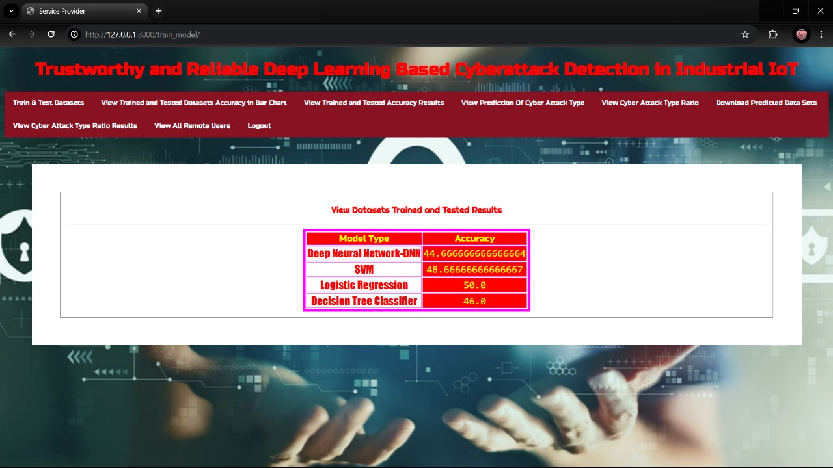
Algorithms

Slide 32
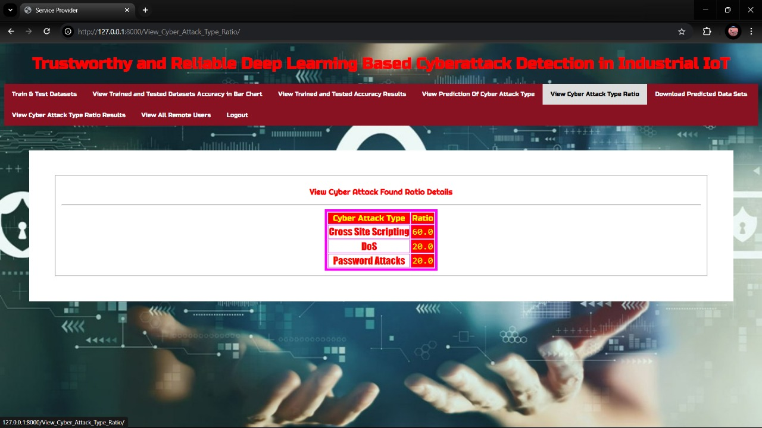
Cyberattacks Types

Slide 33
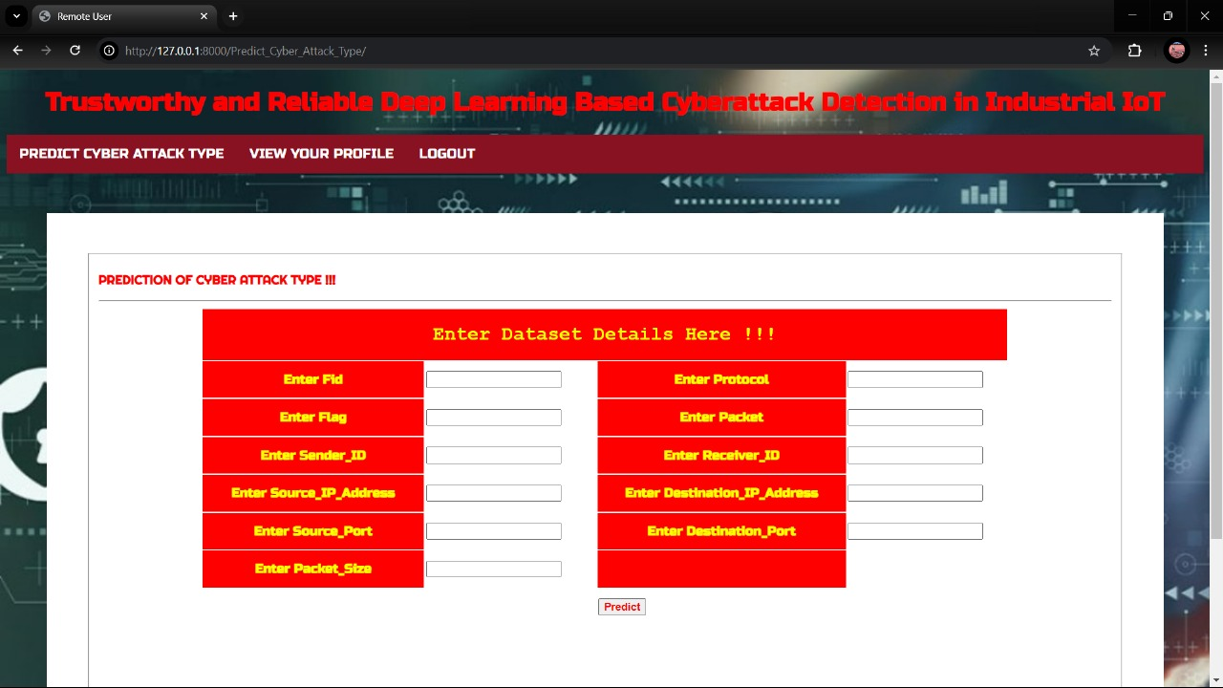
Prediction of Cyber Attack Type

Slide 34
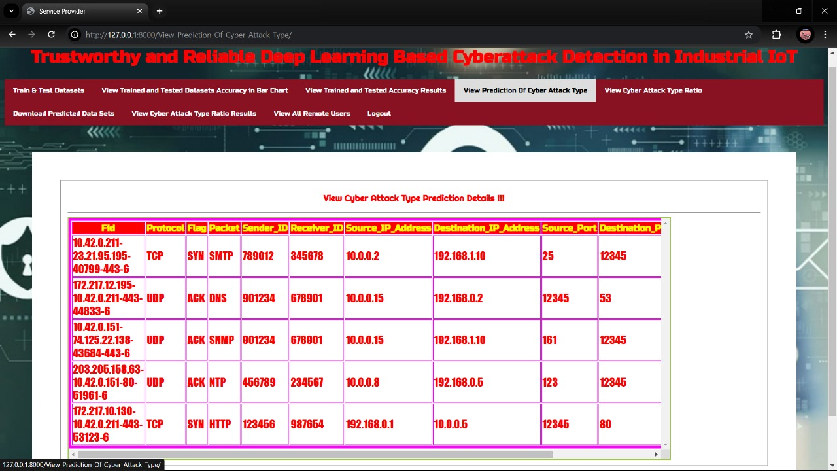
Prediction Details

Slide 35
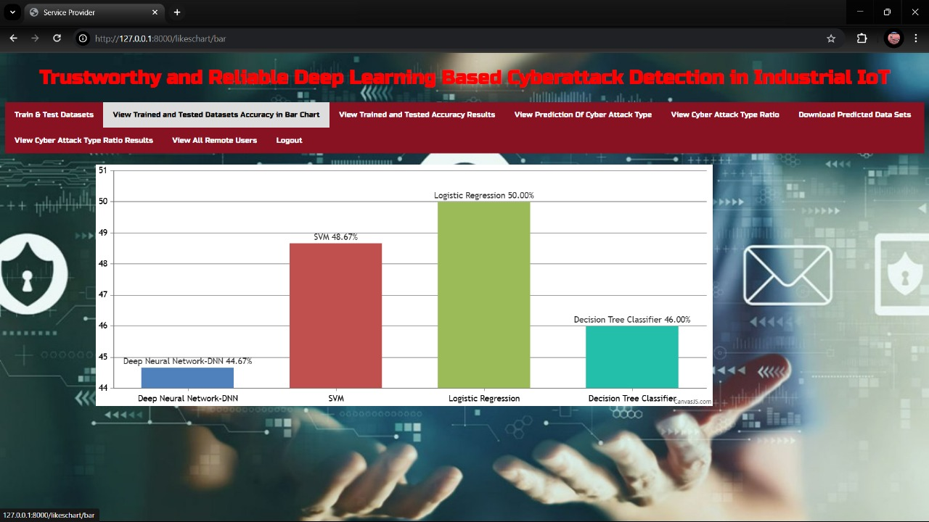
Accuracy in Bar Graph

Slide 36
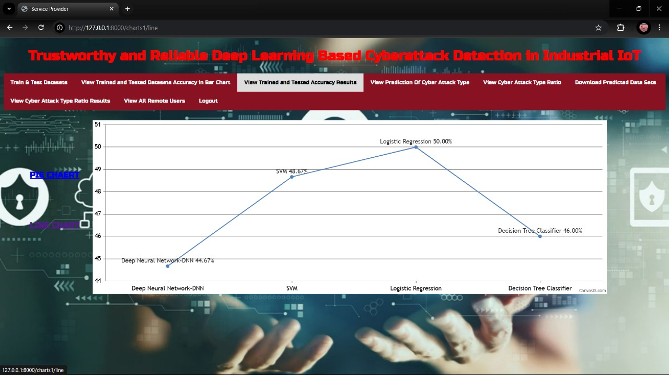
Results Accuracy

Slide 37
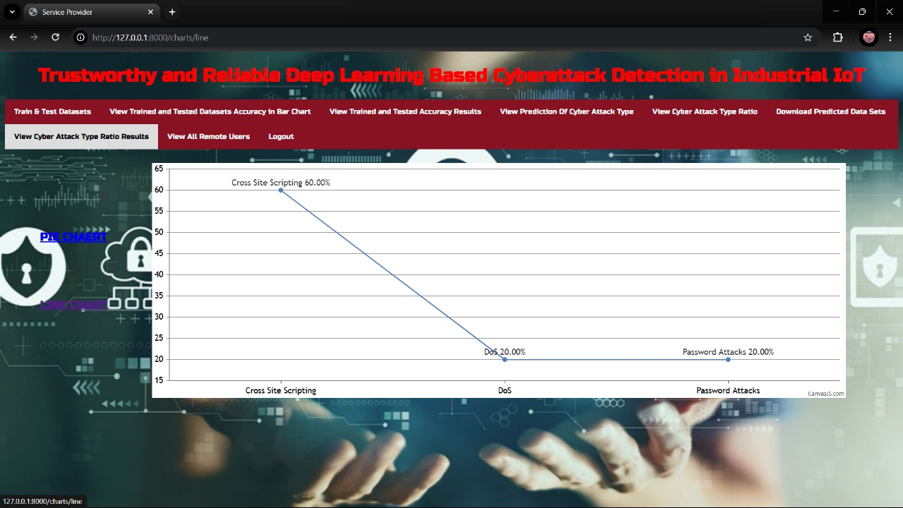
Accuracy Ratio Details

Slide 38
CONCLUSION
In conclusion, the project underscores the critical importance of robust cyberattack detection mechanisms in the rapidly evolving landscape of Industrial IoT. By harnessing the power of deep learning and emphasizing reliability and trustworthiness, the proposed approach offers significant improvements in detecting and mitigating cyber threats.
The ability to adapt to new attack patterns while maintaining high accuracy and real-time response capabilities addresses the unique challenges faced by IIoT environments.
Ultimately, this project not only advances the state of cybersecurity technology but also contributes to the safe and efficient operation of industrial systems, thereby supporting the broader goals of digital transformation and resilience in industry.
In the future, we will employ more powerful deep learning models to further improve trustworthiness by detecting cyber attacks accurately. In addition, we will try to formulate and assess its performance in real-world scenarios. Also, we will work on the selection of optimal features in scenarios when the features are not sufficient.

Slide 39
FUTURE SCOPE
Future advancements can focus on improving real-time cyberattack detection with more efficient deep learning models. The integration of edge and fog computing can enhance response times and reduce reliance on cloud infrastructure.
Strengthening model resilience against adversarial attacks will be crucial for maintaining security. The adoption of federated learning can enable decentralized training while preserving data privacy.
Expanding datasets with diverse attack scenarios will improve model generalization. Implementing blockchain technology for secure logging and authentication can further enhance trust and reliability.
Collaborative research between academia, industries, and cybersecurity organizations will be essential in developing standardized security frameworks for IIoT environments. Regulatory policies and compliance measures will also play a crucial role in shaping the implementation of deep learning-driven cybersecurity solutions in industrial sectors.

Slide 40
REFERENCES
[1] Y. Luo, Y. Duan, W. Li, P. Pace, and G. Fortino, “A novel mobile and
hierarchical data transmission architecture for smart factories,” IEEE
Trans. Ind. Informat., vol. 14, no. 8, pp. 3534–3546, Aug. 2018.
[2] C. Gavriluta, C. Boudinet, F. Kupzog, A. Gomez-Exposito, and R.
Caire, “Cyber-physical framework for emulating distributed control systems
in smart grids,” Int. J. Elect. Power Energy Syst., vol. 114, 2020,
Art. no. 105375.
[3] M. S. Mahmoud, M. M. Hamdan, and U. A. Baroudi, “Modeling and
control of cyber-physical systems subject to cyber attacks: A survey of
recent advances and challenges,” Neurocomputing, vol. 338, pp. 101–115,
2019.
[4] T. Wang, G. Zhang, M. Z. A. Bhuiyan, A. Liu, W. Jia, and M. Xie, “A
novel trust mechanism based on fog computing in sensor–cloud system,”
Future Gener. Comput. Syst., vol. 109, pp. 573–582, 2020.
[5] K. Guo et al., “MDMaaS: Medical-assisted diagnosis model as a service
with artificial intelligence and trust,” IEEE Trans. Ind. Informat., vol. 16,
no. 3, pp. 2102–2114, Mar. 2020.
[6] M. Al-Hawawreh and E. Sitnikova, “Developing a security testbed for
industrial Internet of Things,” IEEE Internet of Things J., vol. 8, no. 7,
pp. 5558–5573, Apr. 2021.

Slide 41
GIT HUB LINK

